Slide 1
Clean code in HTML

Slide 2
Strict DOCTYPE
When authoring document is HTML or XHTML, it is important to Add a Doctype declaration. This makes sure the document will be parsed the same way by different browsers.
The simplest and most reliable doctype declaration to use is the one defined in HTML5: <!DOCTYPE html>

Slide 3
Character set & encoding characters
In <head> section, the first thing should be the declaration is character set (for example UTF-8) so that the browser knows what character set it’s dealing with before it starts reading any content at all
A numeric character reference in HTML refers to a character by its Universal Character Set/Unicode code point, and uses the format
&#nnnn; (in decimal) or &#xhhhh; (in hexadecimal)

Slide 4
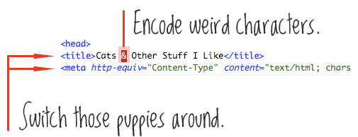
Character set & encoding characters cont.

Slide 5
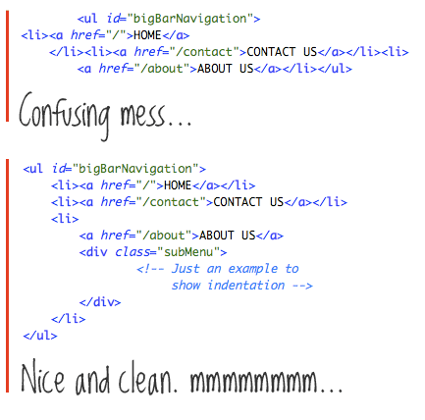
Proper indentation

Slide 6
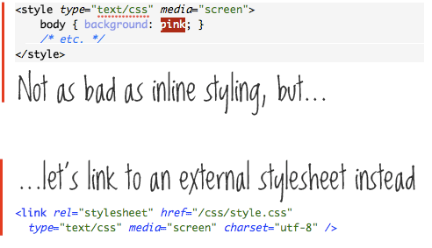
Keep your CSS and JavaScript external

Slide 7
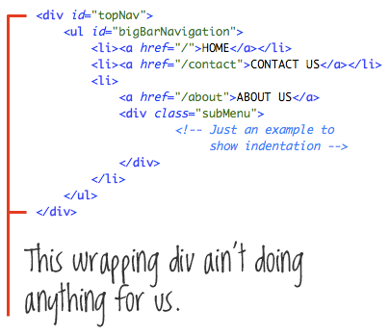
Eliminate unnecessary divs

Slide 8
Use better naming conventions
Good class and id names are things like “mainNav,” “subNav,” “sidebar,” “footer,” “metaData,” things that describe the content they contain.
Bad class and id names are things that describe the design, like “bigBoldHeader,” “leftSidebar,” and “roundedBox.”

Slide 9
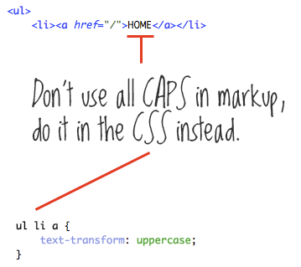
Leave typography to the CSS

Slide 10
ID Your Body
Having unique class and id names for the body is very powerful and has many more uses than just for alternate layouts. Because every bit of page content lies in the “body” tag, you can uniquely target anything on any page with that hook; particularly useful for things like navigation and indicating current navigation, since you’ll know exactly what page you are on with that unique body class.

Slide 11
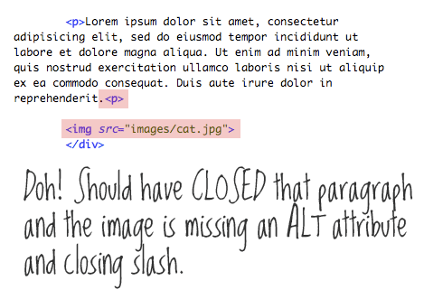
Validate
The W3C Markup Validation Service
https://validator.w3.org/

Slide 12
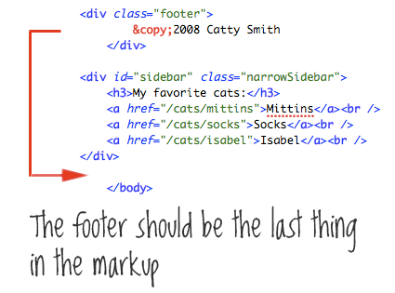
Logical ordering

